Slide 1


FISH Probe Analysis of Polytene Chromosome Separation
Aaron Khan
Mentor: Giovanni Bosco
NASA Space Grant Symposium
April 18, 2009

Slide 2
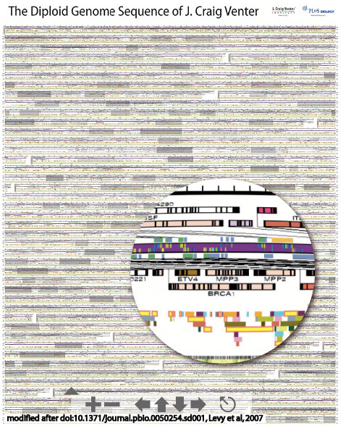
Genomes and genes are
typically depicted as
linear sequences of
nucleotide basepairs...

Slide 3
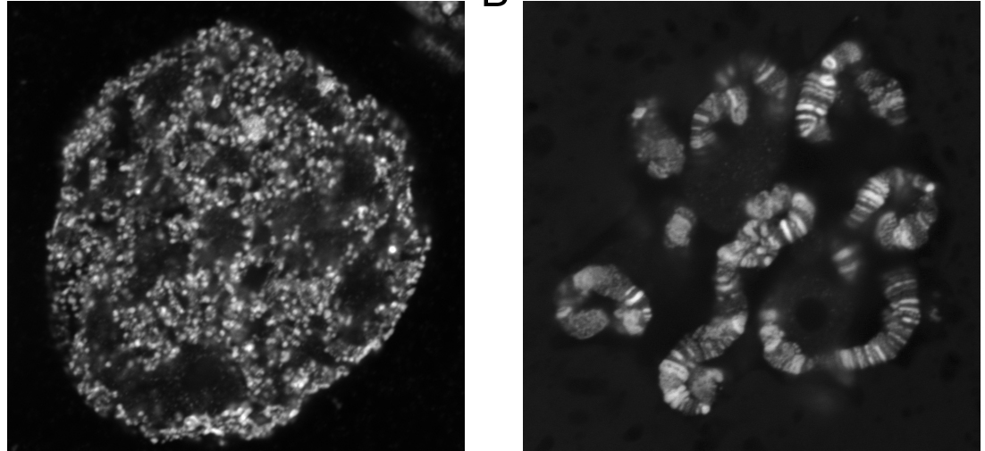
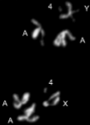
In reality genomes & genes are packaged into DNA/protein
mega-complexes with elaborate and dynamic 3-D structures.

Slide 4
Two big-picture questions:
1. What are the molecular machines that regulate changes in genome organization and chromosome structure?
2. How does chromosome architecture impinge on local gene regulation?

Slide 5
Pairing is the close physical proximity of homologous chromosomes and/or specific homologous sequences.
unpaired
homologs
paired
local regions
paired
homologs
pairing

Slide 6
Pairing of homologous sequences can influence gene expression.
unpaired
homologs
paired
local regions
paired
homologs
pairing
expressed
expressed
repressed
repressed
expressed
expressed

Slide 7
Pairing and inter-chromosomal interactions occur in most eukaryotes, including humans.
There are few known proteins that directly mediate pairing of homologous sequences.
There are no known proteins/mechanisms that promote unpairing.

Slide 8
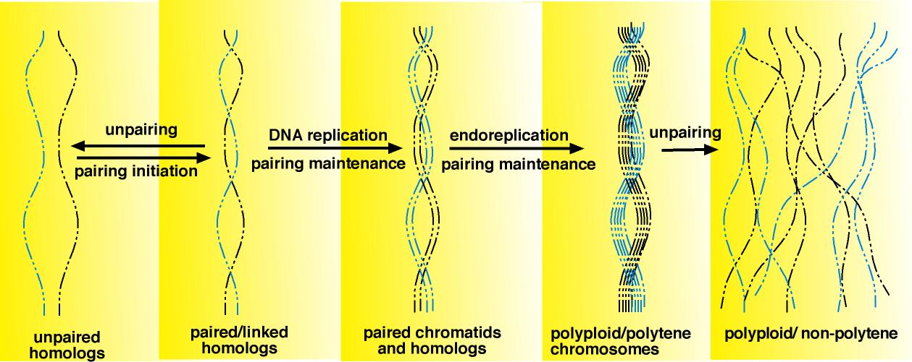
Our story begins with Nurse Cell polytene chromosome.
*Germline cells in the ovary.
*Many copies of each chromosome in one nucleus.
*All sister chromatids and homologs are paired in a
homology dependent manner and then unpair.

Slide 9
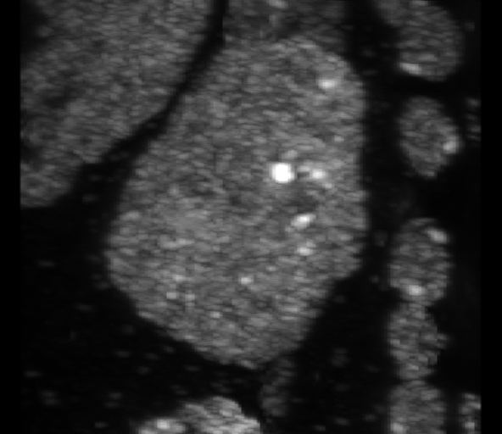
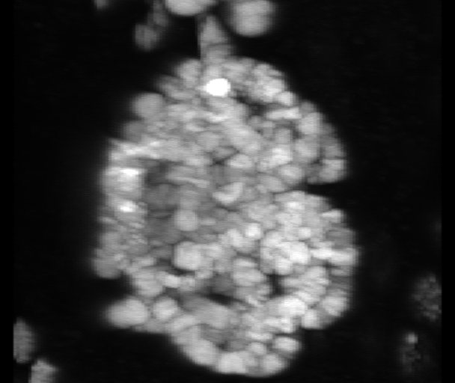
Mutations in the condensin II complex subunit Cap-H2 fail to
unpair ovarian nurse polytene chromosomes.
wild type
Cap-H2^{-/-}

Slide 10
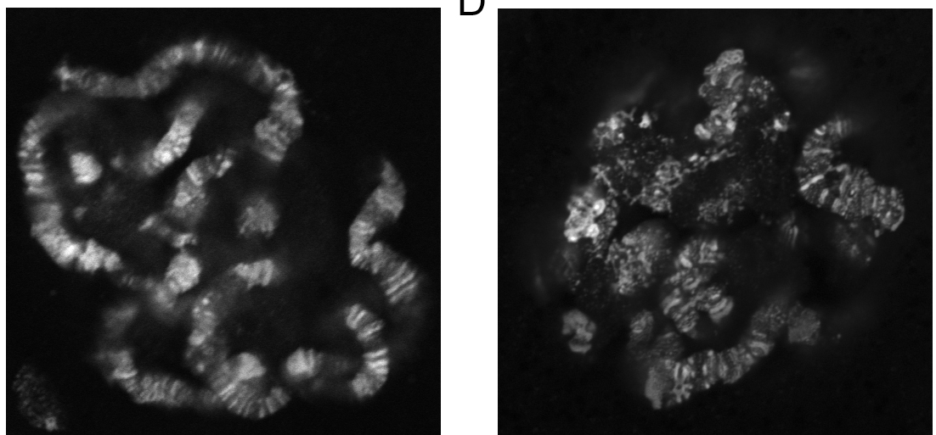
Six independent alleles of Cap-H2 all exhibit polytene nurse cells that fail to unpair.
wild type
Cap-H2 ^{0019/5163}
Cap-H2 ^{0019/Df}
Cap-H2 ^{5163/Df}

Slide 11
Cap-H2 encodes for a subunit of the Condensin II complex.
Smc2
Cap-D3
Cap-H2
Smc4

Slide 12
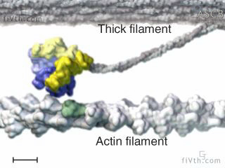
Condensins are ATPase molecular machines.
Smc2
Cap-D3
Cap-H2
2x ATP
Cap-D3
Cap-H2
ATP hydrolysis
Smc4
unlocked
locked

Slide 13
Condensins are ATPase molecular machines.
Smc2
Cap-D3
Cap-H2
ATP
Cap-D3
ATP hydrolysis
Cap-H2
Smc4
Cap-D3
Cap-H2

Slide 14
Condensins are ATPase molecular machines that can move DNA fibers and trap/gather DNA coils.
Cap-H2
binding
ATP
binding
Cap-H2
binding
ATP
hydrolysis
Cap-H2
dissociation
Cap-H2
dissociation

Slide 15
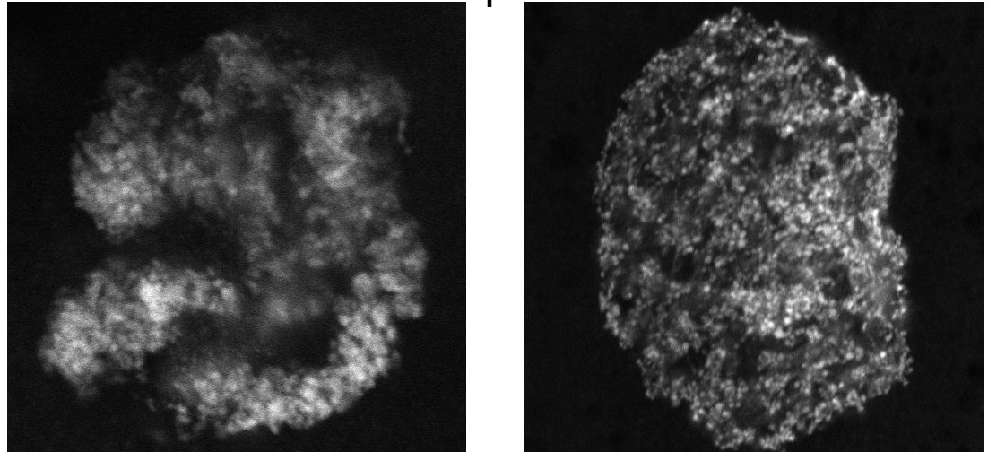
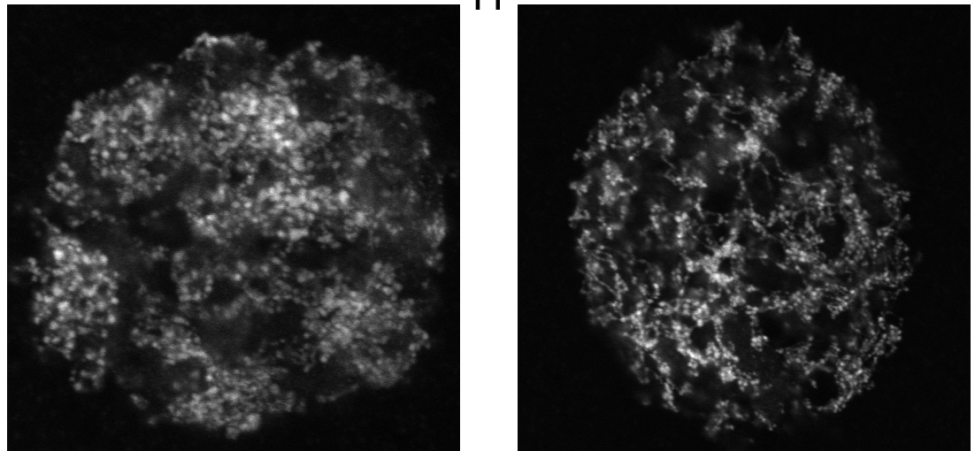
Cap-H2 and SMC4 genetically interact to enhance nurse cellunpairing defect.
SMC4^{+/-} ;CapH2^{+/-}
SMC4^{+/-}
CapH2^{+/-}
Smc4
Cap-D3
Cap-H2
Smc2

Slide 16
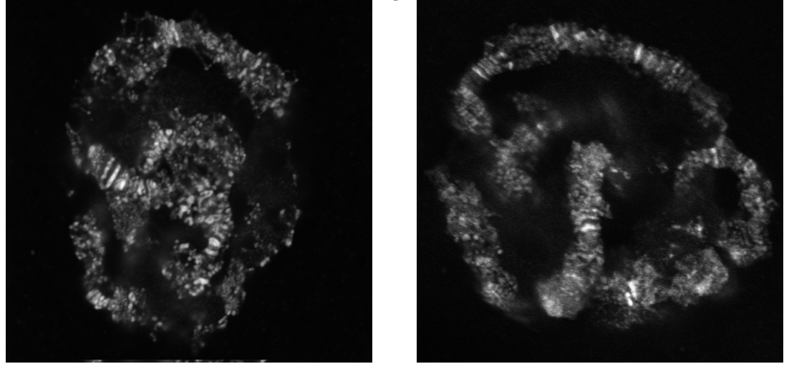
Cap-H2 and Cap-D3 genetically interact to enhance nurse cell unpairing defects.
CapH2^{+/-}
CapD3^{+/-}
Smc4
Cap-D3
Cap-H2
Smc2
CapD3^{-/Df}
CapD3^{-/Df} ;CapH2^{+/-}

Slide 17
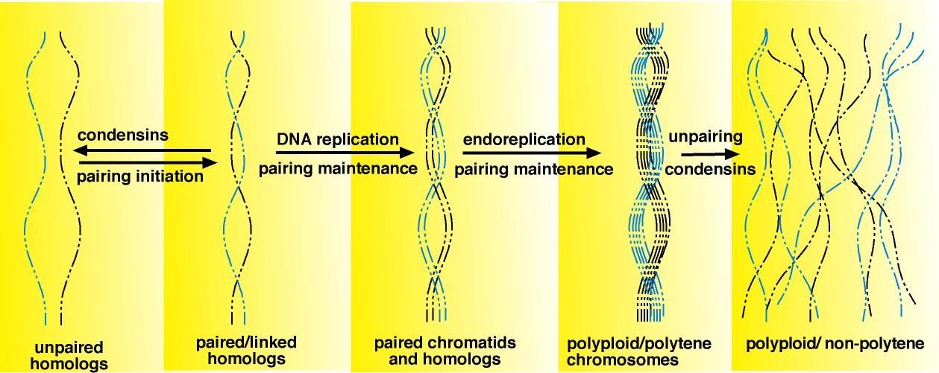
Model: Activation of Cap-H2 induces intra-chromosomal coils &
disrupts inter-chromosomal (paired) associations most likely
in the context of a condensin complex.
Paired
Unpaired

Slide 18
Our working model:
Nurse cell polytenes undergo a condensin regulated unpairing step.
Salivary polytenes have insufficient condensin activity.

Slide 19
Thank you

